Slide 1
Software project lab – I
Project Title: A Digital Watch
Presented by
Tulshi Chandra Das
Roll: BSSE 0811
Supervised by
Amit Seal Ami
Lecturer, IIT DU

Slide 2
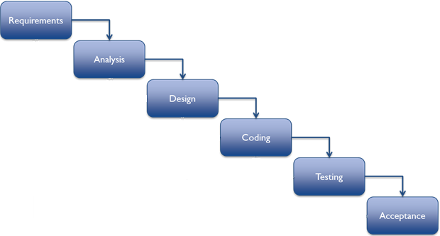
Methodology
Figure: Steps of methodology

Slide 3
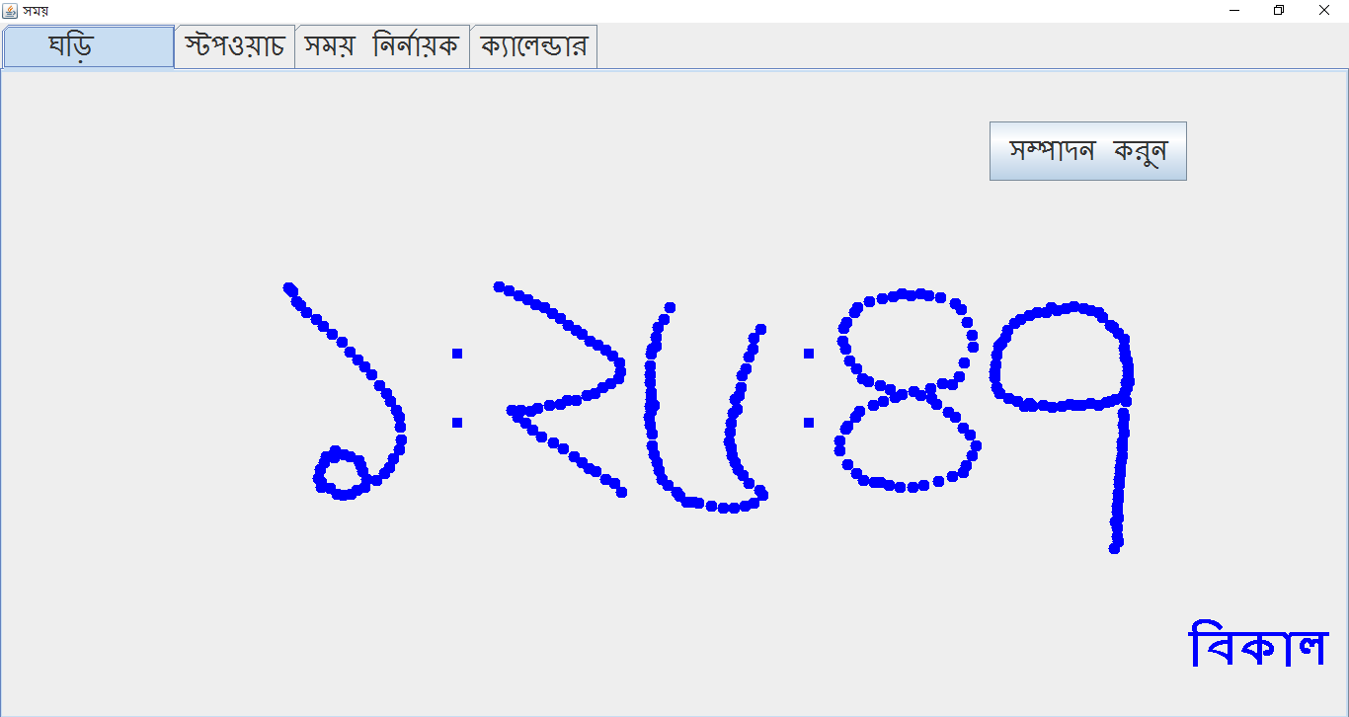
Output
Figure: Output when program start to run

Slide 4
Thank you

